Slide 1

Principles of Management: Guiding Organizational Success
PRESENTED BY: RISHABHA KUMAR MISHRA
SEMESTER : 1ST
SUBJECT: MANAGEMENT FUNDAMENTALS

Slide 2

Why Management Matters
Management is the art of getting things done through people. It involves planning, organizing, leading, and controlling resources to achieve specific goals efficiently and effectively. Think of it as the foundation upon which successful organizations are built.

Slide 3
Defining Management Principles
"Principles of Management are fundamental truths or guidelines that serve as a guide for managerial action and decision-making."
These principles are derived from practical experience and research, offering a framework for managers to navigate complex organizational challenges and foster a productive environment.

Slide 4
Key Features of Management Principles
Universal Application
Flexible
Applicable to all types of organizations, regardless of size or nature.
Can be modified and adapted to suit specific situations and changing environments.
Behavioral
Cause & Effect
Influence human behavior and aim to improve relationships within the organization.
Indicate how certain decisions or actions will lead to specific outcomes.

Slide 5




The Importance of Principles
Guidance & Direction
Improved Efficiency
Help managers make informed decisions and solve problems effectively.
Optimize resource utilization and streamline operations for better productivity.
Effective Leadership
Social Responsibility
Foster better communication, motivation, and team cohesion.
Encourage ethical practices and a balanced approach to stakeholder needs.

Slide 6
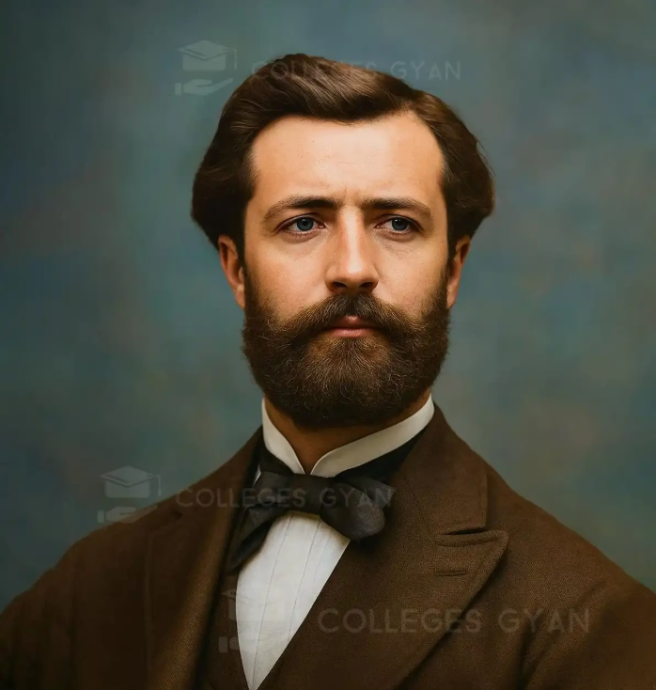
Henri Fayol: The Father of Modern Management
His Contributions:
Systematic Approach: Provided a structured way to understand and apply management.
Universal Principles: Argued that management principles are applicable to all types of organizations.
Focus on Administration: Emphasized the importance of administrative functions for organizational success.
Born in 1841, Henri Fayol was a French mining engineer who developed one of the first comprehensive theories of management. His 14 Principles of Management, outlined in his 1916 book "Administration Industrielle et Générale," remain highly influential.

Slide 7




Fayol's 14 Principles: A Practical Guide
These principles offer timeless wisdom for effective organizational leadership.
1. Division of Work
2. Authority & Responsibility
Specialization boosts efficiency; individuals focus on their strengths.
Authority to command entails accountability for results.
3. Discipline
4. Unity of Command
Adherence to rules ensures smooth operations.
Employees report to only one superior.

Slide 8




5. Unity of Direction
6. Subordination of Individual Interest
One head and one plan for a group of activities with the same objective.
Organizational interests must come before individual interests.
7. Remuneration
8. Centralization
Fair pay for employees and employers for continuous motivation.
The degree to which authority is concentrated or dispersed.

Slide 9



9. Scalar Chain
10. Order
A clear line of authority from top management to the lowest ranks.
A place for everything and everyone, and everything and everyone in its place.
11. Equity
12. Stability of Tenure of Personnel
Fair and kind treatment of all employees for loyalty and devotion.
Minimizing employee turnover is crucial for efficiency.

Slide 10


13. Initiative
14. Esprit de Corps
Encouraging employees to propose and execute their own ideas.
Promoting team spirit, unity, and harmony among employees.

Slide 11
Conclusion: Guiding Your Organization to Success
Fayol's 14 Principles provide a timeless framework for effective management, enabling leaders to build strong, efficient, and harmonious organizations. These foundational guidelines empower managers to make informed decisions, foster clear communication, and ensure optimal resource utilization. By consistently applying these fundamental truths, organizations can navigate complexities, foster productivity, and achieve sustainable success in an ever-evolving business landscape.
In today's dynamic and competitive environment, the core tenets of Fayol's principles remain as relevant as ever. They encourage a balanced approach to leadership, emphasizing not just structure and authority, but also employee well-being, fairness, and team spirit. Embracing these principles is not merely about adherence to rules, but about cultivating an organizational culture where efficiency, harmony, and growth flourish. Continual reflection on and application of these insights will be key to guiding your organization towards its full potential.
Questions?

Slide 12
Thank You!

